Slide 1
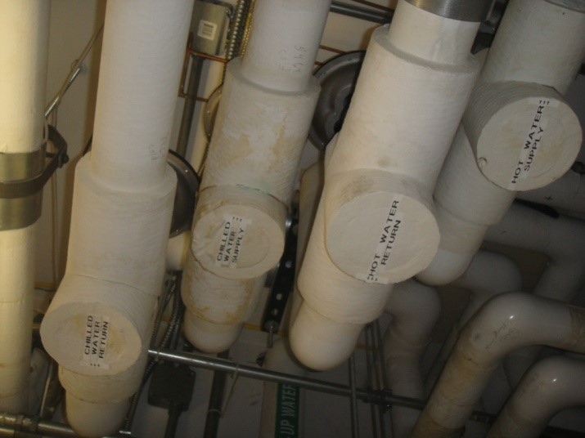
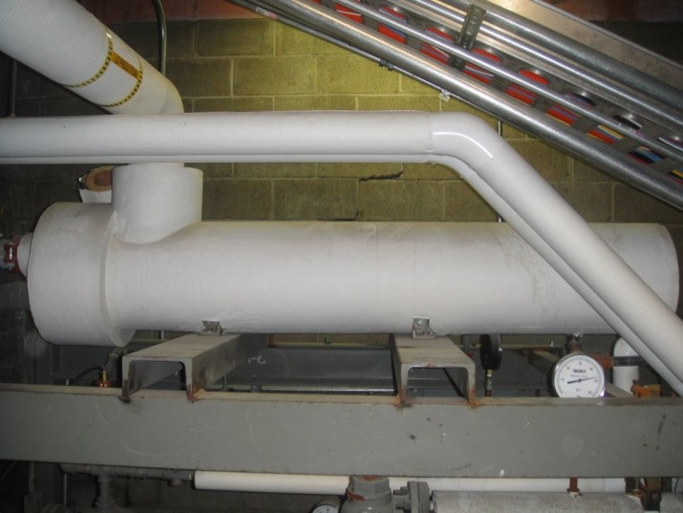
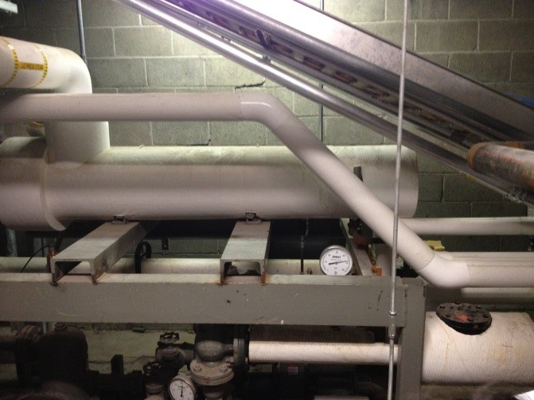
Supply/return pipes
Heat exchanger
in the basement
Hot water pump

Slide 2
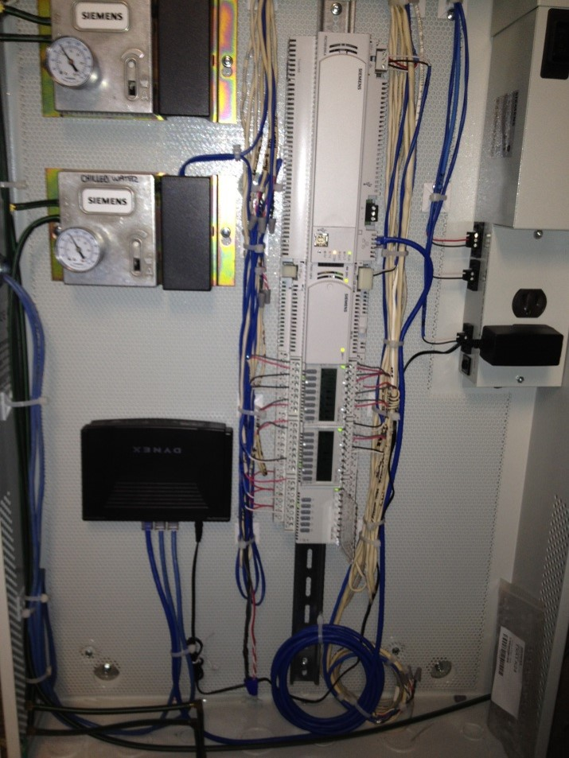
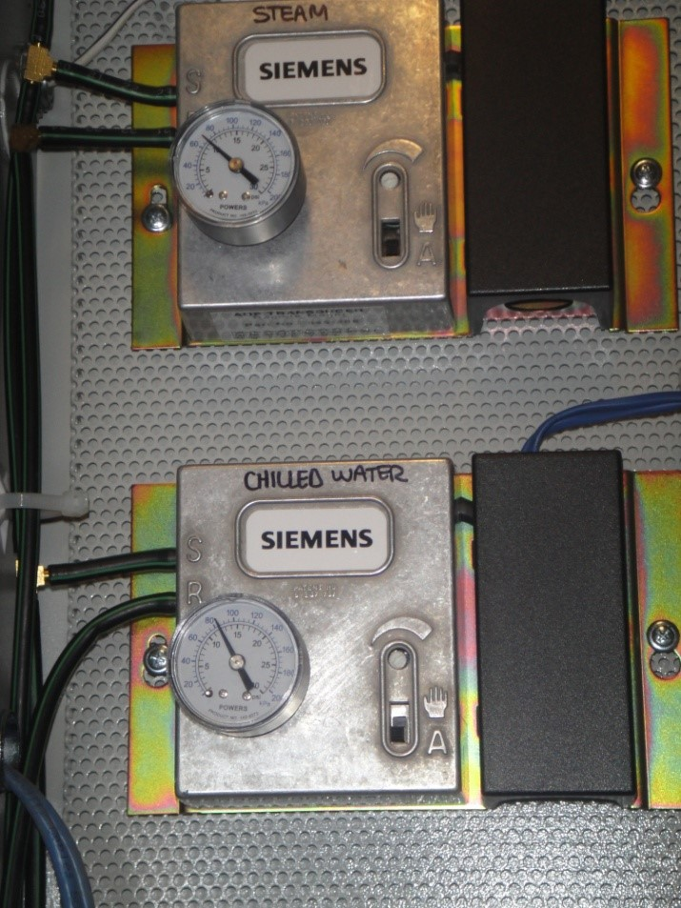
Siemens control panel
in the basement
Close up of steam and
chilled water control

Slide 3
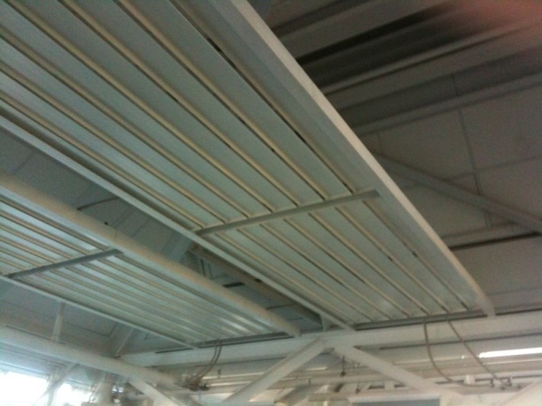
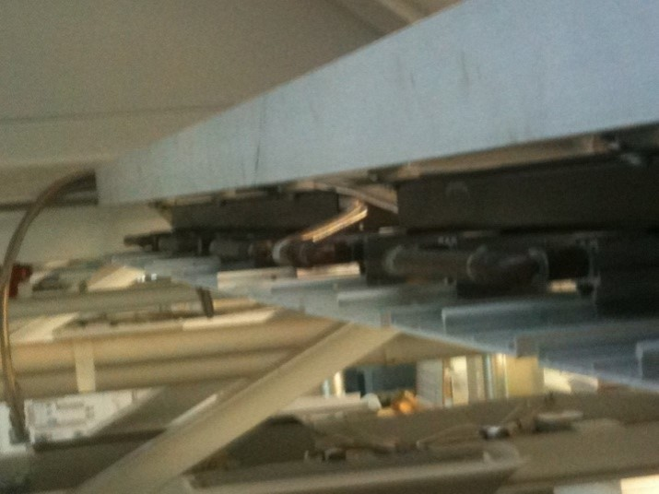
Metal panels that radiate heat
Back-side of the metal panel
with copper tubing

Slide 4
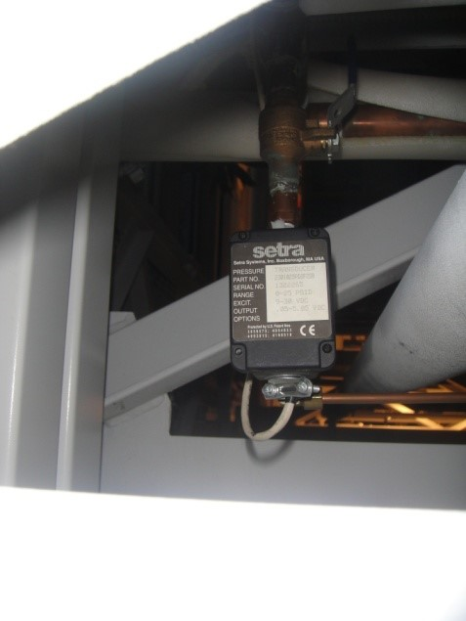
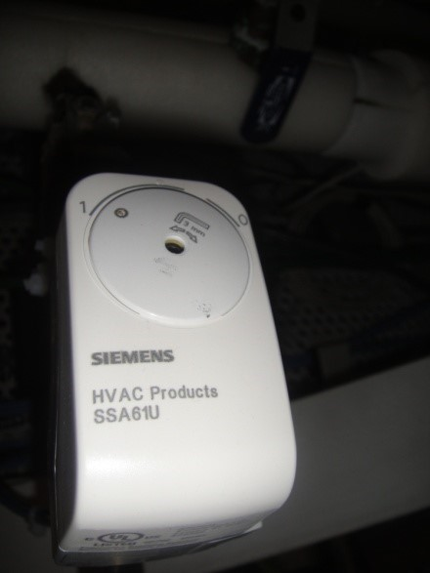
Sentra to measure flow rate
Siemens sensor to measure temperature

